Slide 1

Implementation of Algorithms using CUDA, and their Performance Comparison
Anuja B. S. 1NH10CS019
Chaitra J. R. 1NH10CS022
Kusuma Chandrika K. 1NH10CS047
Nitin Kaveriappa U. M. 1NH10CS061

Slide 2
Objective
This project is focused on exploiting GPU (Graphics Processing Unit) for general purpose computing based on CUDA (Compute Unified Device Architecture).
It aims at utilization of GPU cores through direct access of GPU computing using CUDA that enables straightforward implementation of parallel algorithms.
Diamond Square, Quickhull and Smith Waterman algorithms were implemented in CUDA C and C language and the algorithms were compared on performance and efficiency.

Slide 3
Introduction
Compute Unified Device Architecture (CUDA) is a parallel computing platform
Programming model created by NVIDIA
Implemented by the graphics processing units (GPUs) that they produce.

Slide 4
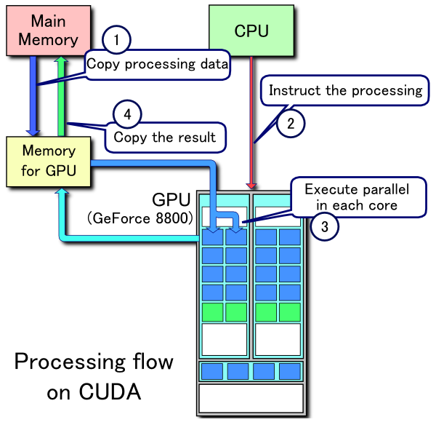
Processing Flow on CUDA

Slide 5
General Keywords and Functions
Header file: The header file used for CUDA is #include<cuda.h>
_global_: The __global__ qualifier declares a function as being a kernel.
Executed on the device, callable from the host,
__global__ functions must have void return type.
Ex: __global__ void subhtKernel( );
cudaMalloc():
A single address space is used for the host and all the devices.
Syntax: cudaMalloc(void ** pointer, size_t nbytes)
Ex: cudaMalloc((void**) &d_j, sizeof(int));

Slide 6
cudaMemcpy():
Memory is typically allocated using cudaMalloc() and freed using cudaFree().
Data transfer between host memory and device memory are done through this function.
Syntax: cudaMemcpy(void *dst, void *src, size_t nbytes, enum cudaMemcpyKind direction);
Ex: cudaMemcpy(d_j, &j, sizeof(int), cudaMemcpyHostToDevice);
cudaMemcpy(d_j, &j, sizeof(int), cudaMemcpyDeviceToHost);
Syntax: cudaFree(void* pointer)
Ex: cudaFree(d_j);

Slide 7
Function call(kernel):
CUDA threads that execute that kernel for a given kernel call is specified using a new
<<<...>>> execution configuration.
Syntax: Function_name<<< no.of blocks, no.of threads/blocks>>>
Ex: subhtKernel<<<1, j>>>( );
Each thread that executes the kernel is given a unique thread ID that is accessible within the kernel through the built-in threadIdx variable.
cudaDeviceSynchronize():
Blocks until the device has completed all preceding requested tasks. CudaDeviceSynchronize() returns an error if one of the preceding tasks has failed.

Slide 8
__shared__:
The __shared__ qualifier, declares a variable that:
‣ Resides in the shared memory space of a thread block,
‣ Has the lifetime of the block,
‣ Is only accessible from all the threads within the block.
When declaring a variable in shared memory as an external array such as
Ex: extern __shared__ float shared[];

Slide 9
threadIdx:
threadIdx is a 3-component vector
threads can be identified using a one-dimensional, two-dimensional, or three-dimensional thread index.
Ex: int tid = threadIdx.x;(1-d)
__syncthreads():
If the threads belong to the same block, in which case they should use __syncthreads() and share data through shared memory.

Slide 10
CUDA Function
__global__ void subhtKernel(int *limit) { extern __shared__ kernel_shared_type sdata[]; unsigned int tid = threadIdx.x; if (tid < *limit) { __syncthreads(); } }
points subht(int j) { int *d_j; cudaMalloc((void**) &d_j, sizeof(int)); cudaMemcpy(d_j, &j, sizeof(int), cudaMemcpyHostToDevice); subhtKernel<<<1, j>>>(d_j,); cudaDeviceSynchronize(); cudaMemcpy(&j, d_j, sizeof(int), cudaMemcpyDeviceToHost); cudaFree(d_j); }

Slide 11
Non - CUDA Function
points subht(int j) { double h[200]; for(i=0;i<j;i++) { //find the point with max distance from the baseline } }

Slide 12
CUDA AND IT’S DOMAINS
Graphical Rendering
Volume rendering using 2-3 swap image compositing
GPU accelerated volume rendering on an interactive light field display
Diamond Square Algorithm
Geometric Computation
Geometric problems on 3D meshes
Parallel Convex Hull Algorithm
Quickhull Algorithm
Genomics
Smith Waterman Algorithm

Slide 13
Introduction to Diamond Square Algorithm
The diamond-square algorithm is a method for generating height-maps for computer graphics.

Slide 14
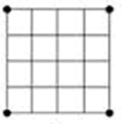
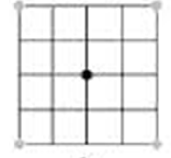
Diamond Square Algorithm
Step 1: Create a 2D array. The size of the array is determined by the amount of iterations (i.e. 1 iteration-3x3 array, 2 iterations-5x5 array etc).
Step 2: Assign a start value to the four corners of the map.
Step 3: Call the Diamond() method.

Slide 15
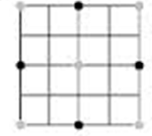
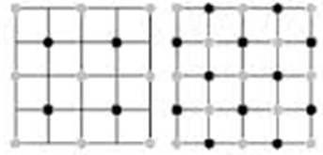
Diamond Square Algorithm
Step 4: Call the SquareEven() method.
Step 5: Call the SquareOdd() method.
Step 6: Go back to step 3 and repeat the steps until iterations >= 0.
Step 7: Display the map.

Slide 16
Flowchart for Diamond Square Algorithm
Start
Create a 2D array and assign an initial value to the corner of the map.
Iteration >= 0
Diamond( )
SquareEven( )
SquareOdd( )
Display the map
Stop

Slide 17
Diamond()
SquareEven()
SquareOdd()
Calculate the average values of the four corners of smallest possible square
Calculate the average values of the four corners of smallest possible diamond
Calculate the average values of the four corners of smallest possible diamond
Add a random value to the average and insert into the map.
return Height map
return Height map
return Height map

Slide 18
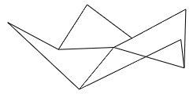
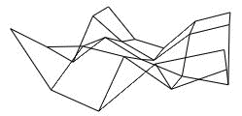
Implementation
After the first pass if we were to connect the nine points , we might get a wireframe surface which looks like this:
When we perform the second pass with 12 diamond centres ,we need to calculate 12 new values . 25 elements of the array have been arranged and the wireframe would look like above:

Slide 19
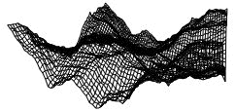
Had a larger array been allocated we could add more detail in each pass and the surface would like this

Slide 20
Non-CUDA Performance Graph

Slide 21
Performance Comparison
No. of iterations | Non CUDA execution time(ms) | CUDA execution time(ms)
2 | 0.00 | 152.00
4 | 0.00 | 152.25
6 | 0.00 | 144.25
8 | 0.00 | 156.00
10 | 82.00 | 206.75
12 | 1220.50 | 990.75
13 | 4779.00 | 1367.33

Slide 22
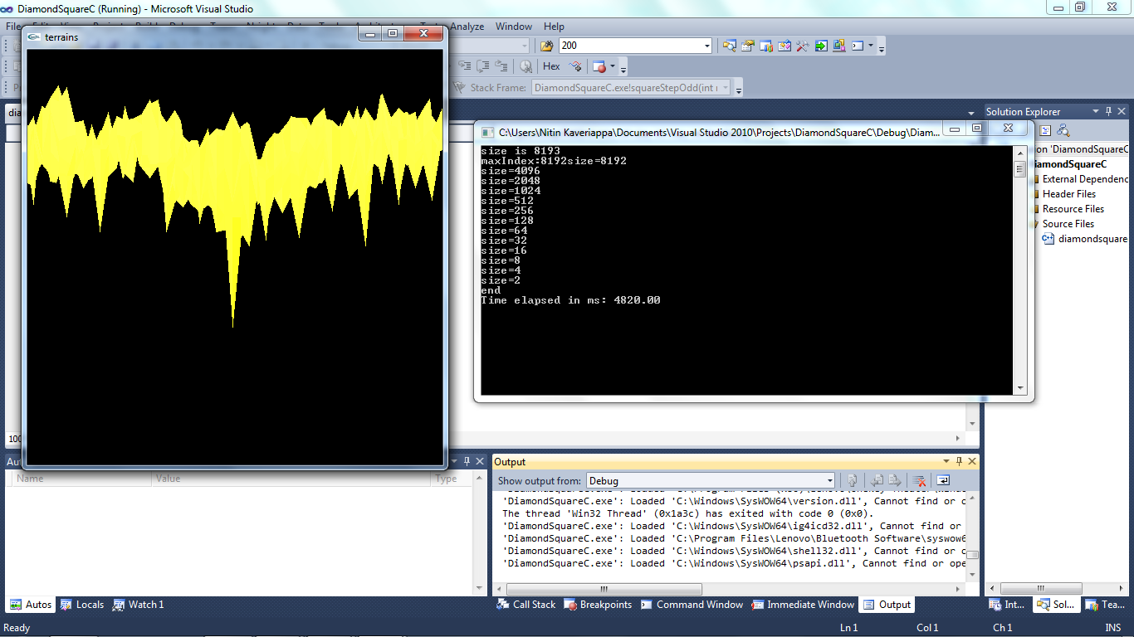
Non-CUDA Output

Slide 23
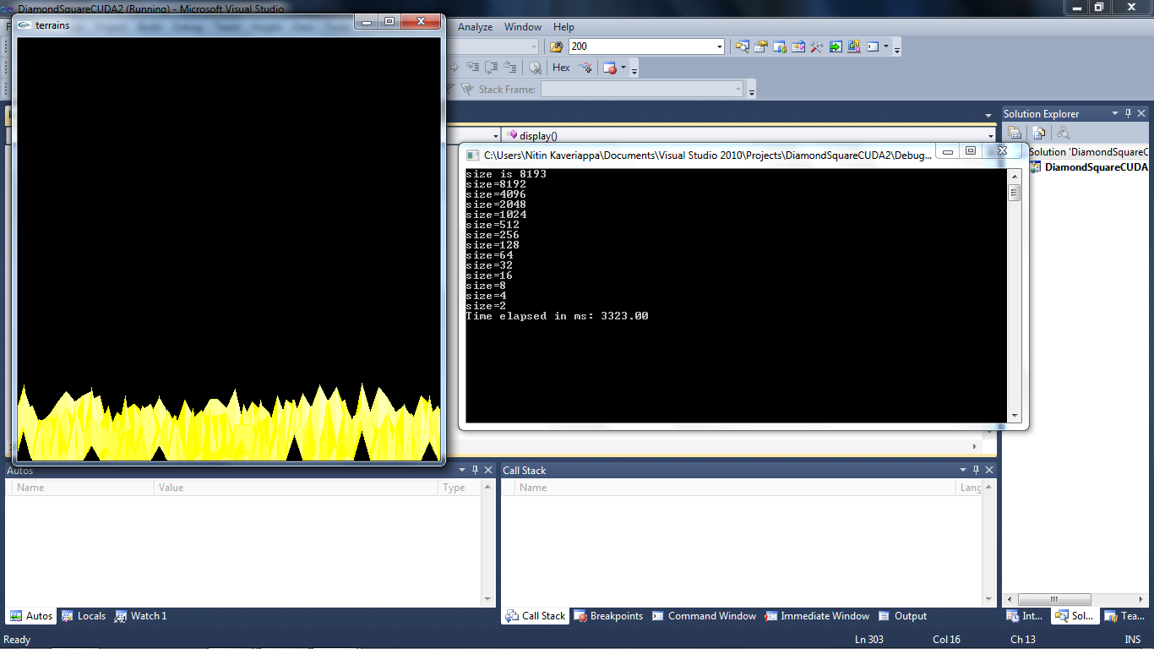
CUDA Output

Slide 24
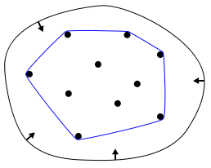
Introduction to QuickHull Algorithm
QuickHull is a method of computing the convex hull of a finite set of points in the plane.
It uses a divide and conquer approach.

Slide 25
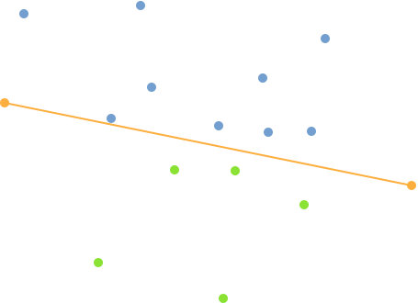
QuickHull Algorithm
Step 1: Points consists of x and y coordinates.
Step 2: Find two points furthest away from each other and this is baseline PQ.
Step 3: This PQ line divides points into 2 subsets S₁ and S₂.

Slide 26
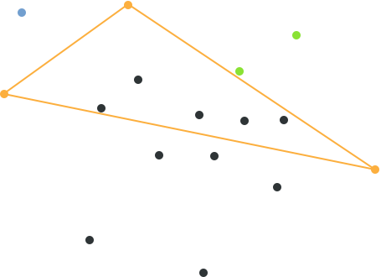
Step 4: From line segment PQ find the point with the maximum distance from the line. Let it be ‘A’.
A triangle is formed and the points inside the triangle is ignored.

Slide 27
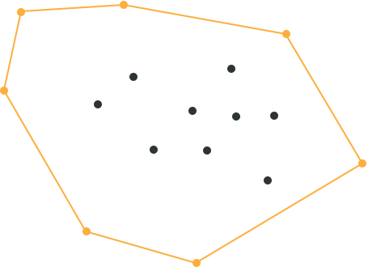
Step 5: Repeat these steps until no points are left and connect these points.

Slide 28
Flowchart for QuickHull Algorithm
Start
Find the points with min and max y coordinate and connect them and add these points to the Final_hull.
A

Slide 29
A
Using this line find the point which is farther away from the line. Connect these points to form a triangle. Add this point to the Final_hull.
Find the points which lies inside this triangle. Ignore these points in the next iteration.
Any points left outside the triangle?
Connect all the points in the Final_hull. These points constitute the hull.
Stop

Slide 30
Graph of execution time for Quickhull C and CUDA C program for smaller number of points

Slide 31
Graph of execution time for Quickhull C and CUDA C program for medium number of points

Slide 32
Graph of execution time for Quickhull C and Quickhull CUDA C program

Slide 33
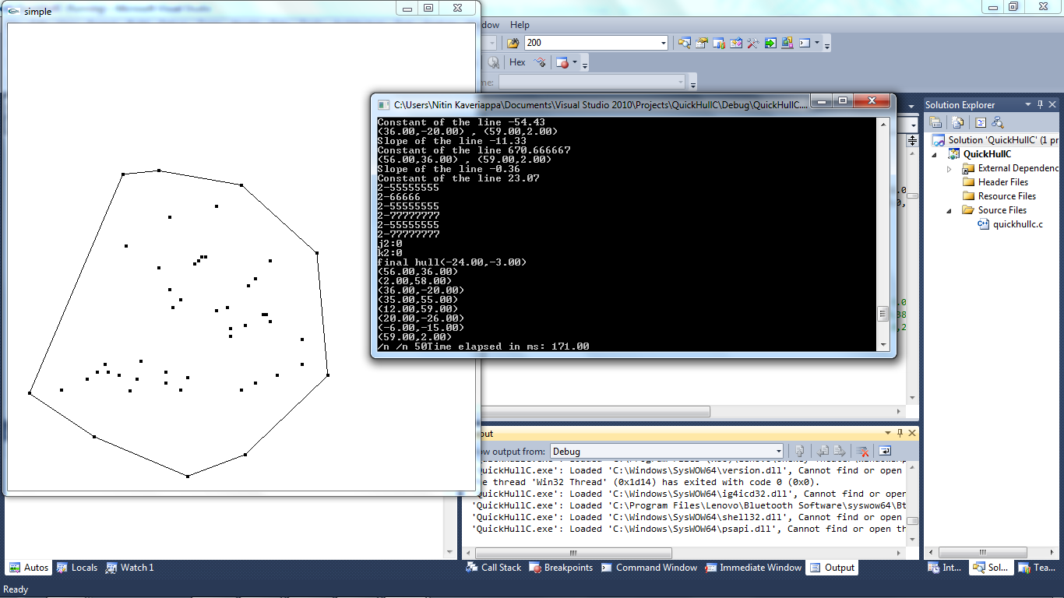
Non-CUDA Output

Slide 34
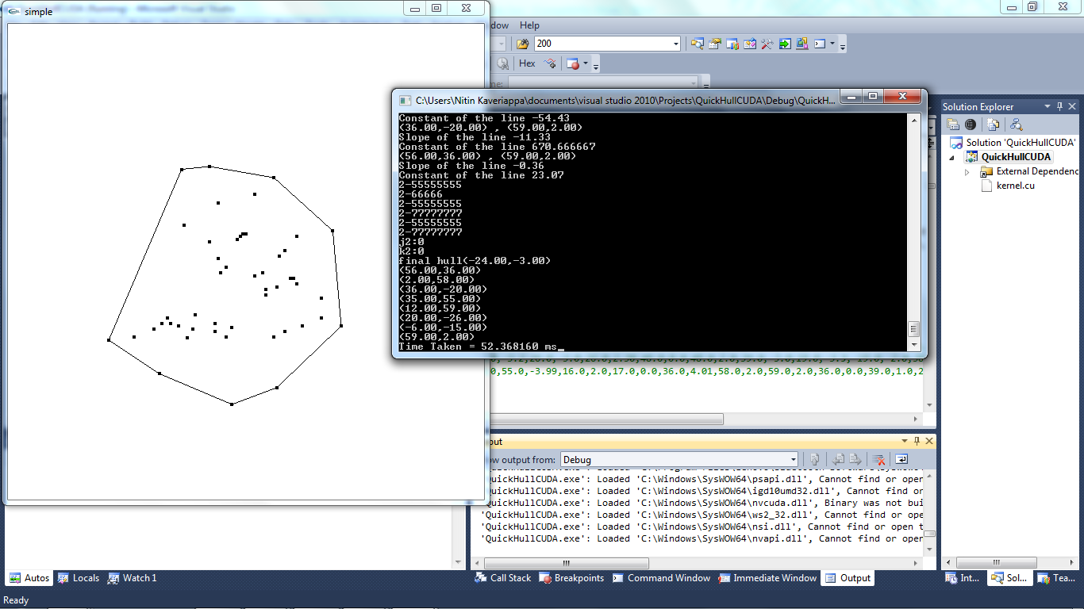
CUDA Output

Slide 35
Introduction to Smith-Waterman Algortihm
Optimal local alignment of two sequences
Performs an exhaustive search for the optimal local Alignment
Based on the 'dynamic programming' algorithm
Fill the matrix
Find the maximal value (score) in the matrix
Trace back from the score until a 0 value is reached

Slide 36
Smithwaterman Algorithm
Initialisation: a,b->Strings over the alphabet ∑ m->length of (a) n->length of (b) H(i,j)->is the max similarity score between a suffix of a[1....i] and a suffix of b[1....j] W(c,d), c, d ϵ ∑ U{‘-‘},’-‘ is the gap scoring scheme
Steps: Matrix H is built as follows: H(i,0)=0, 0 <= i <=m H(0,j)=0, 0 <=j<=n If ai=bj, then W(ai,bj)=W(match) or If ai!=bj, then W(ai,bj)=W(mismatch)

Slide 37
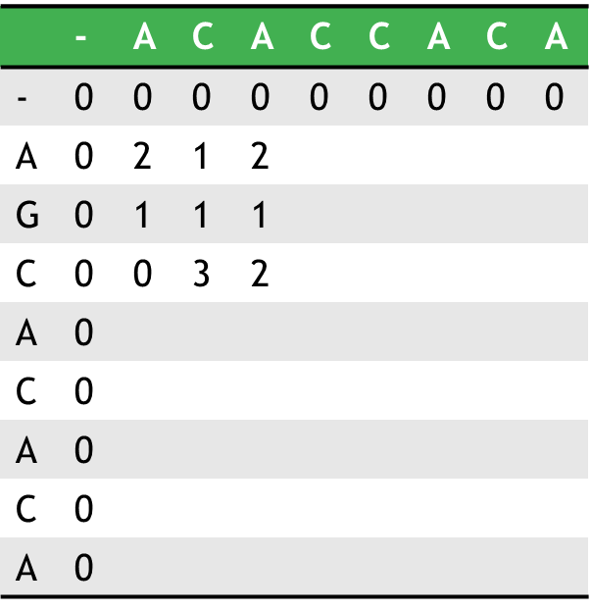
H(i,j)= max { H(i-1,j-1+w(ai,bj) Match/mismatch H(i-1,j)+W(ai,-) Deletion H(i,j-1)+W(-,bj) Insertion } for 1<=i<=m and 1<=j<=n Where W (match)=+2 W(a,-)=W(-,b)=W(mismatch)=-1
Output: Scoring matrix H

Slide 38
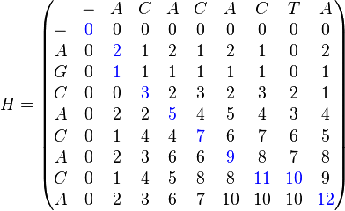
Input: Scoring matrix H
Output: Alignment matrix T

Slide 39
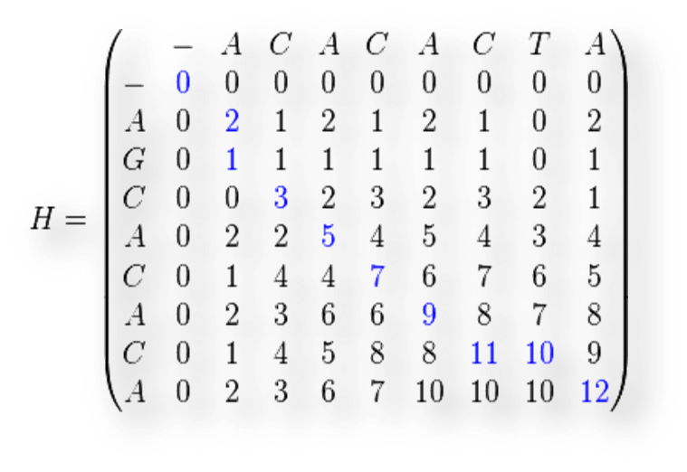
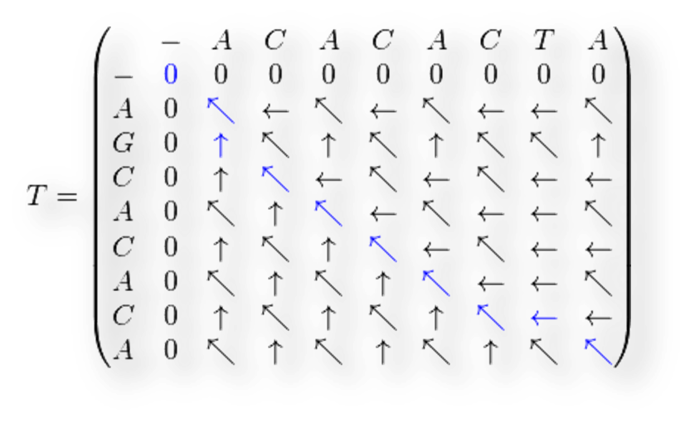
Input: Alignment matrix T.
Output: Optimal local alignment of sequences a and b i.e. for determining similar regions between two strings.
For the example, the results are: Sequence 1 = A-CACACTA Sequence 2 = AGCACAC-A

Slide 40
Flowchart for Smith Waterman Algorithm
Start
Input a, b
Length of a->m
Length of b->n
Void scoringmat()
Void allignmat()
Void localAllign()

Slide 41
Void scoringmat()
For i=0 to M
H(i,0)=0
I
For j=0 to n
H(0,j)=0
J
W(match)=0
W(match)+=2
W(a,-)=W(-,b)=W(mismatch)=-1
A

Slide 42
A
Is ai=bj
?
False
True
W(ai,bj)=W(mismatch)
W(ai,bj)=W(match)
For i=0 to M
B
Is H(i-1,j-1)+W(ai,bj)>
H(i-1,j)+W(ai,-) ?
For j=0 to N
C
D

Slide 43
D
Is H(i-1,j-1)+W(ai,bj)>
H(i-1,j)+W(ai,-) ?
True
False
Is H(i-1,j-1+W(ai,bj)>
H(i,j-1)+W(-,bj) ?
Is H(i-1,j)+W(ai,-)>
H(i,j-1+W(-,bj) ?
False
False
True
True
H(i,j)=H(i-1,j-1)+W(ai,bj)
H(i,j)=H(i-1,j)+W(ai,-)
H(i,j)=H(i,j-1)+W(-,bj)
I
B
J
C
Output H(i,j)
Stop

Slide 44
void allignmat()
Select the matrix cell with highest value in the matrix(i,j)
Go backwards to one of the positions (i-1, j), (i, j-1) and (i-1, j-1) depending on the direction used to construct the matrix
Go backwards and repeat until a matrix cell with zero value is reached

Slide 45
void localAllign()
Starting with the last value, reach (i, j) using previously calculated path
Diagonal jump implies there is an alignment i.e. either a match or a mismatch
Top down jump implies there is a deletion
Left right jump implies there is an insertion
Optimal local alignment of sequences a and b i.e. for determining similar regions between two strings

Slide 46
Non-CUDA Performance Graph

Slide 47
CUDA Performance Graph

Slide 48
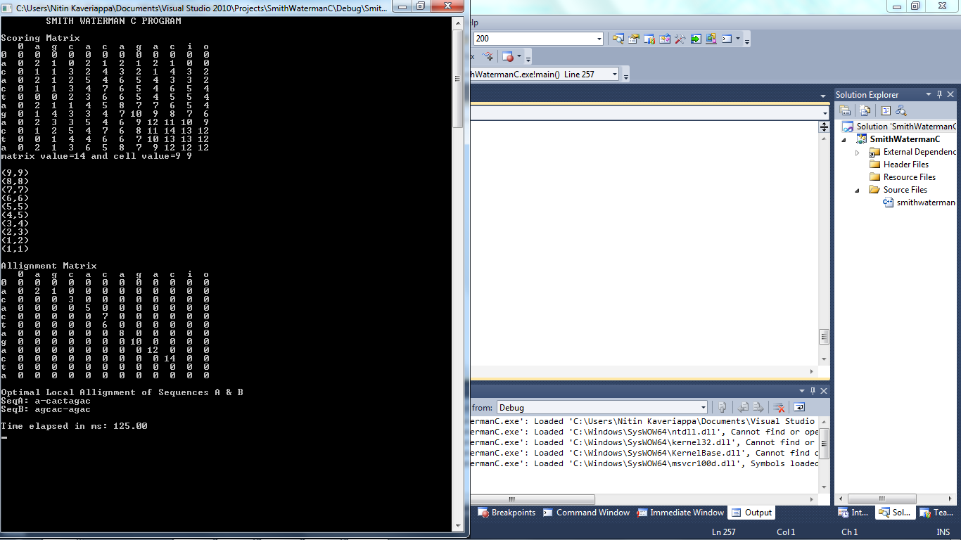
Non-CUDA Output

Slide 49
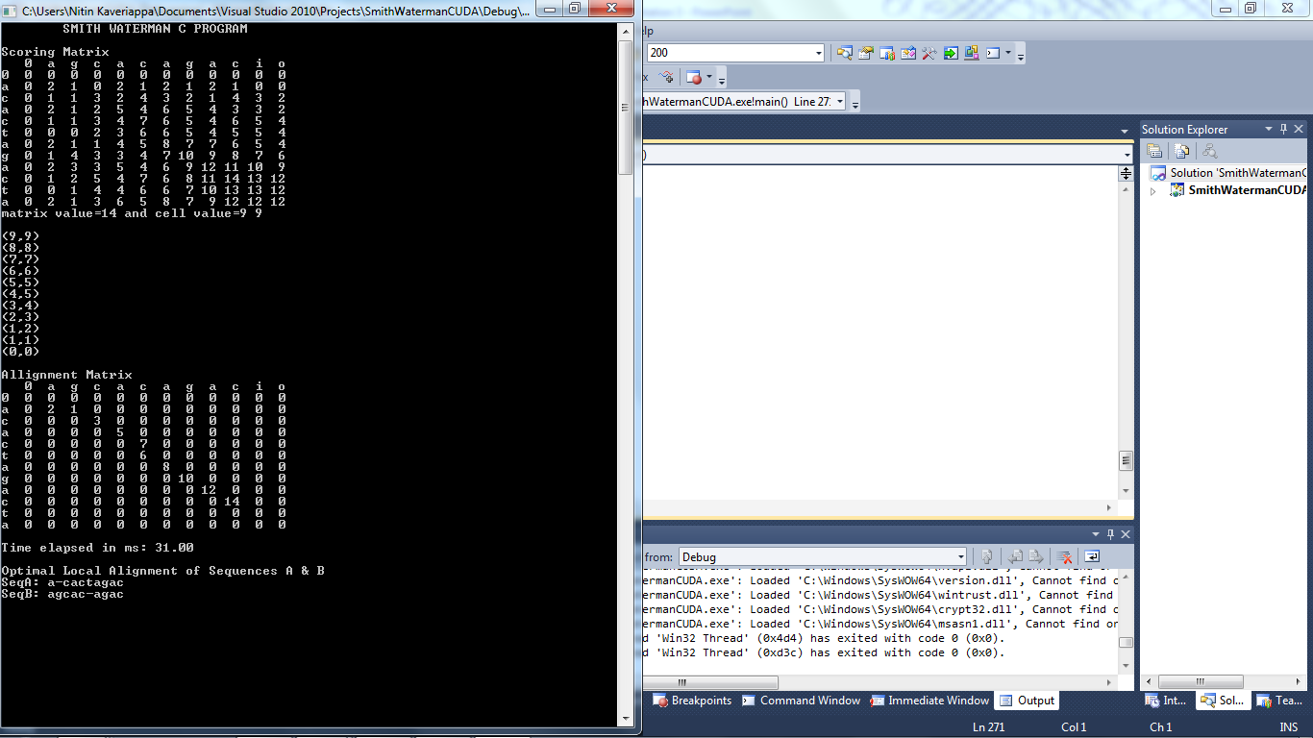
CUDA Output

Slide 50
Conclusion
The use of CUDA for small inputs may actually increase the execution time rather than decreasing it because of the time taken for memory transfers between the CPU and GPU
As in the CPU the GPU also has a hardware limit known as the computational capability which is determined by the number of cores contained in the GPU. This restricts the maximum size of the input or number of iterations
We have observed that as the computational need of a program increases the execution time decreases when compared with CPU vs GPU, hence improving the overall performance program execution

Slide 51
Thank You.

